Slide 1
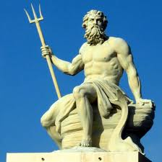
Poseidon – God of the seas.
Zeus’ brother.
Very important because Greeks relied on his kindness for their paychecks.
In artwork, he always carries the Trident – a three-pronged spear.

Slide 2
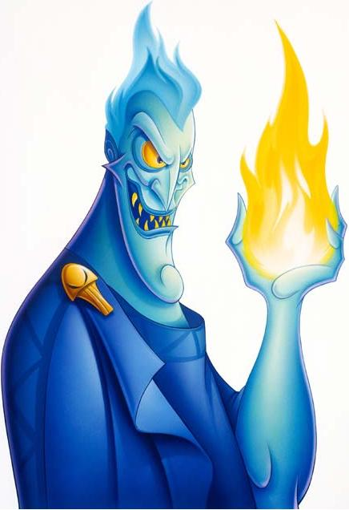
Hades – God of the land of the dead
Unwanted and unwelcome at Olympus.
Has no pity (still not considered an evil god).
Had a helmet that made the wearer appear invisible.

Slide 3
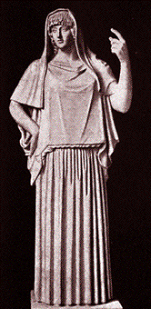
Hestia – Goddess of the Hearth and domestic life.
Usually pictured with a tea kettle
Zeus’ sister
One of the 3 virgin goddesses.

Slide 4
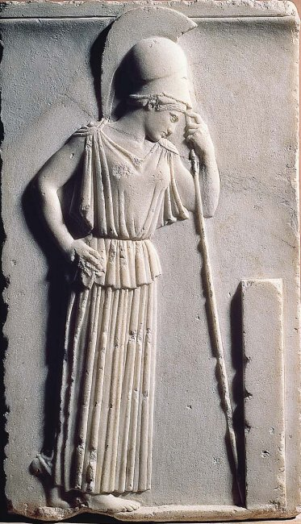
(The rest of the 12 Great Olympians are grandchildren of Cronus – mostly fathered by Zeus.)
Athena – The goddess of wisdom and war.
Zeus’ favorite.
Athena sprang fully-grown and dressed in armor from Zeus’ head.
The second virgin goddess.
Often called the Maiden.

Slide 5
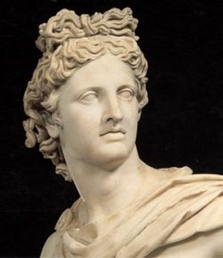
Apollo – A beautiful god and a master musician.
Entertains the gods by playing on his golden lyre.
He is god of archery, prophecy, and music.
He is sometimes called god of the sun, but the actual Sun-god is Helios.

Slide 6
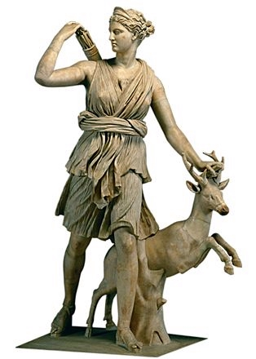
Artemis – The last of the virgin goddesses
Apollo’s twin
The goddess of the moon & the hunt.
She is known for having two faces: good and evil.

Slide 7
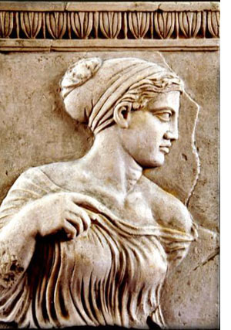
Aphrodite – Goddess of love and beauty
Born from the sea
Zeus made her marry the ugliest (and steadiest) of the gods, Hephaestus.

Slide 8
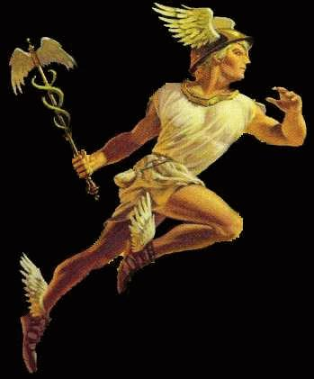
Hermes – The god of speed
The messenger of the gods
Often pictured with winged sandals, a winged hat, and a magic wand.

Slide 9
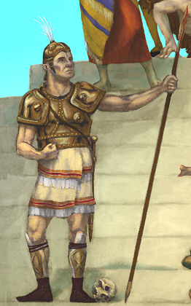
Ares – Greek god of war
Ruthless
Both Zeus and Hera (his parents) hated him.
Not important in Greek mythology (usually just a symbol of war).

Slide 10
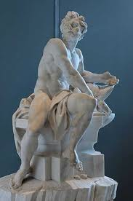
Hephaestus – god of fire
Popular on earth and on Olympus.
Born so lame and ugly that his mom threw him off Mt. Olympus.
Hephaestus forged the gods’ armor and built their houses

